Slide 1
Slide by Jeroen van der Sluijs

Slide 2
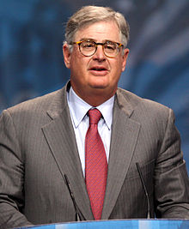
Palmisano, Sam (2010), Welcome to the decade of smart, Royal Institute of International Affairs Chatham House, London, January 12th 2010,
http://online.wsj.com/public/resources/documents/palmisano_decadeofsmart-jan12.pdf
Let me leave you with one final observation, culled from our learning over the past year. It is this: Building a smarter planet is realistic precisely because it is so refreshingly
non-ideological.
Notes:
was president and chief executive officer of IBM until 2012.[Chairman of the company until 20

Slide 3
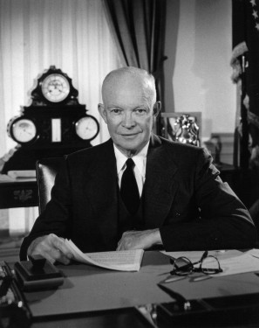
Eisenhower's Farewell Address to the Nation January 17, 1961 http://www.informationclearinghouse.info/article5407.htm
Today, the solitary inventor, tinkering in his shop, has been overshadowed by task forces of scientists in laboratories and testing fields. In the same fashion, the free university, historically the fountainhead of free ideas and scientific discovery, has experienced a revolution in the conduct of research. Partly because of the huge costs involved, a government contract becomes virtually a substitute for intellectual curiosity. For every old blackboard there are now hundreds of new electronic computers.
The prospect of domination of the nation's scholars by Federal employment, project allocations, and the power of money is ever present – and is gravely to be regarded. Yet, in holding scientific research and discovery in respect, as we should, we must also be alert to the equal and opposite danger that public policy could itself become the captive of a scientific-technological elite.

