Slide 1






Louise Edwards
Hub Manager
The SAPEA MECHANISM
Ole H Petersen CBE MAE ML FRS
Esther Dorado-Ladera
Executive Officer
Juliet Davies
Executive Officer

Slide 2







Sierd Cloetingh MAE
President of Academia Europaea
Chair of SAPEA Board

Slide 3






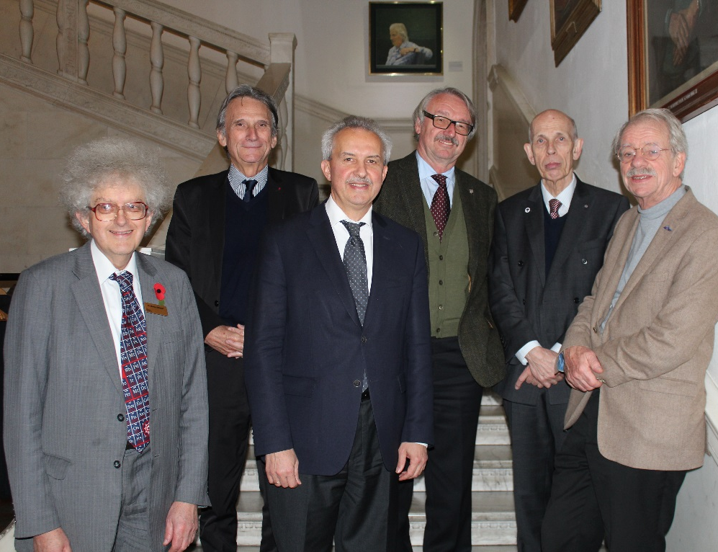
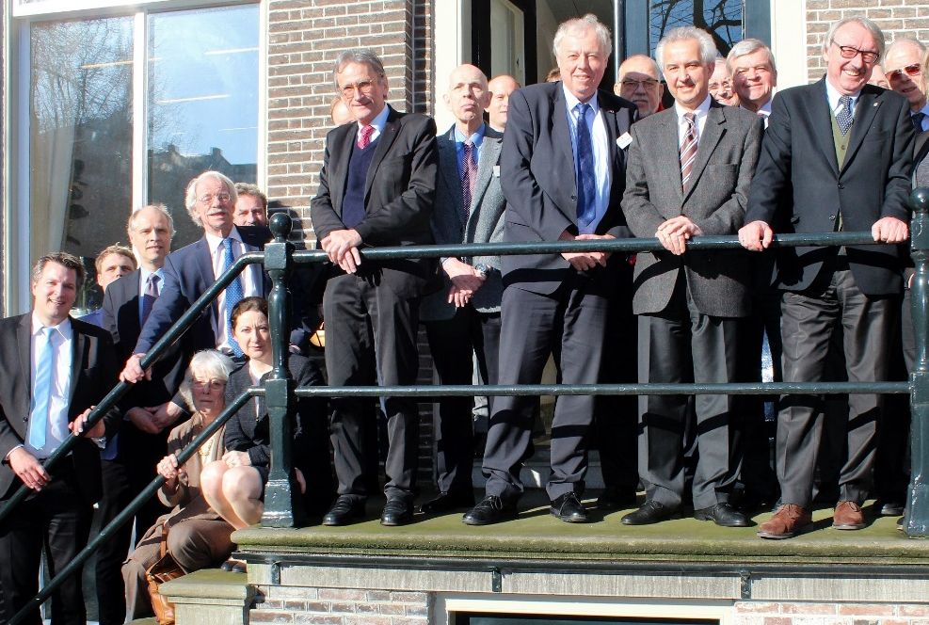
HORIZON 2020
The EU Framework Programme for Research and Innovation
Science Advice for Policy by European Academies
Bernard
Charpentier
Sierd
Cloetingh
Günter
Stock
Bernard
Charpentier
Günter
Stock
Jos van
der Meer
Ole
Petersen
Reinhard
Hüttl
Reinhard
Hüttl
Martyn
Poliakoff
Jos van
der Meer
The Royal Society
London, November 2015
The Royal Netherlands Academy of Arts and Sciences Amsterdam, February 2016

Slide 4
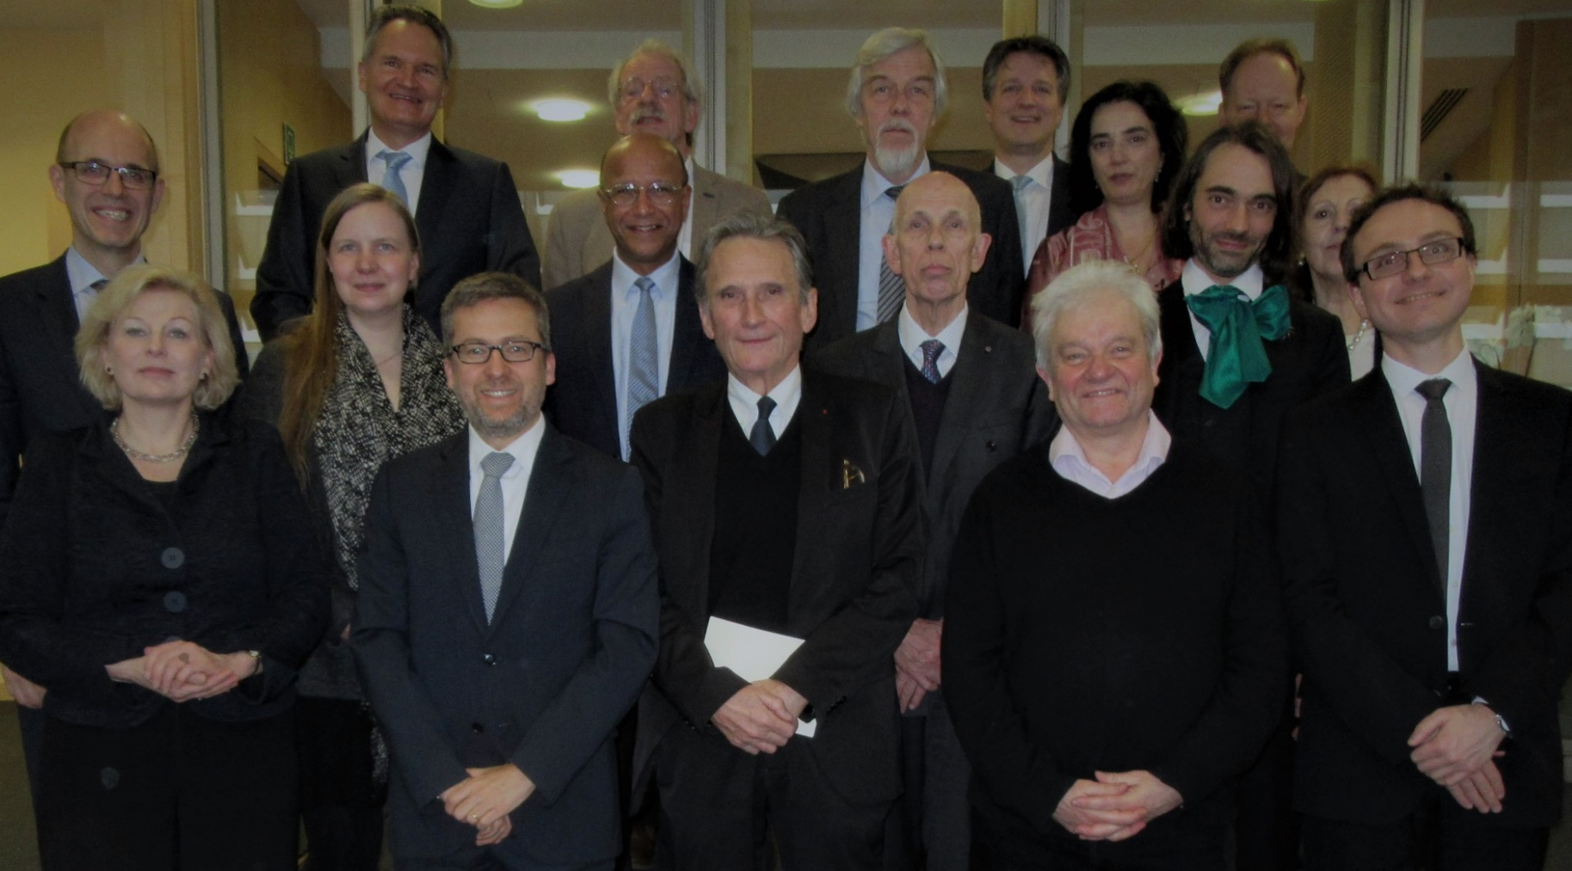

HORIZON 2020
The EU Framework Programme for Research and Innovation
Science Advice for Policy by European Academies
European Commission, The Berlaymont, Brussels, 30th January 2017

Slide 5
SAM:
The European Commission’s Scientific Advice Mechanism
GCSA
SAPEA provides Evidence, Analysis and Policy Options. On the basis of the SAPEA Evidence Review Report (ERR), GCSA formulates a Scientific Opinion (SO). The ERR and the SO are usually published at the same time.

Slide 6
The Scientific Advice (SAPEA’s ERR + GCSA’s SO) is then available for the European Commission to initiate evidence-informed proposals for policy or legislation

Slide 7
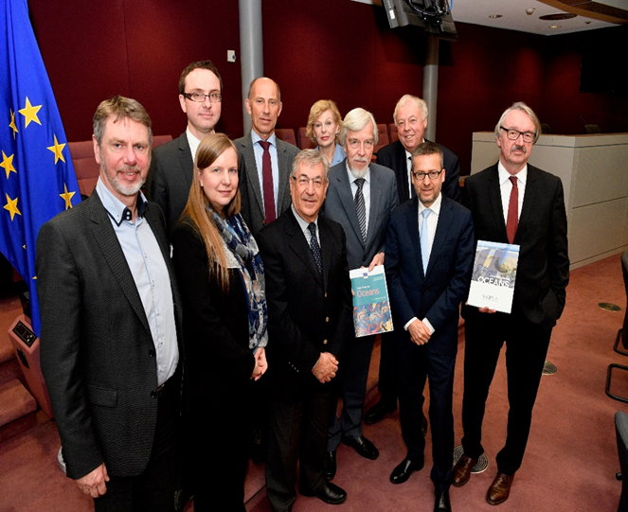
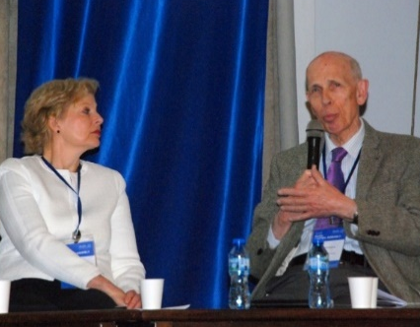
The work on the first SAPEA Evidence Review Report was led by Academia Europaea
Evidence Review Report
Scientific Opinion
Handover to European Commissioners,
Brussels, November 2017
Debate on ‘Food from the Oceans’ at the Bulgarian Academy of Sciences, Sofia, May 2018
Front cover, Food from the Oceans Evidence Review Report
Front cover, Food from the Oceans
Group of Chief Scientific Advisors’ Scientific Opinion

Slide 8
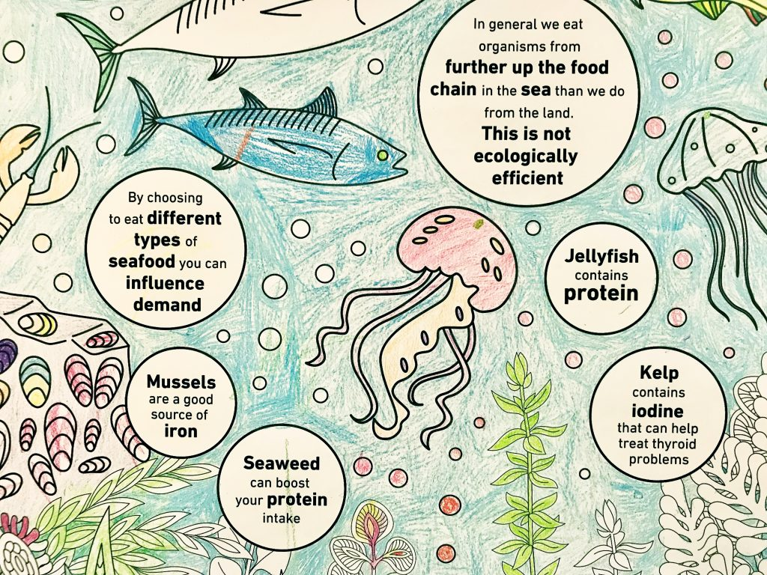

Slide 11
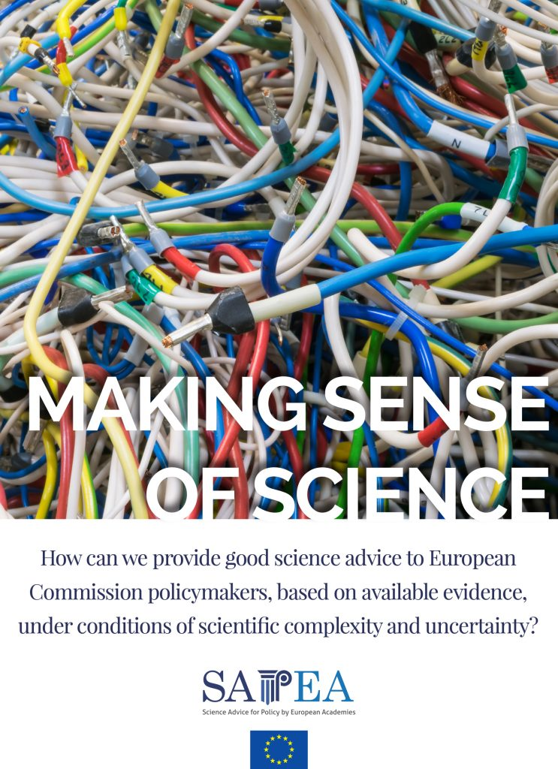

MASOS
Making Sense of Science for Policy (under conditions of uncertainty, complexity and ambiguity)
Professor Ortwin Renn ML
Chair of the MASOS Working Group
The three Working Group meetings were held at the Berlin-Brandenburg Academy in Berlin in autumn 2018

Slide 12
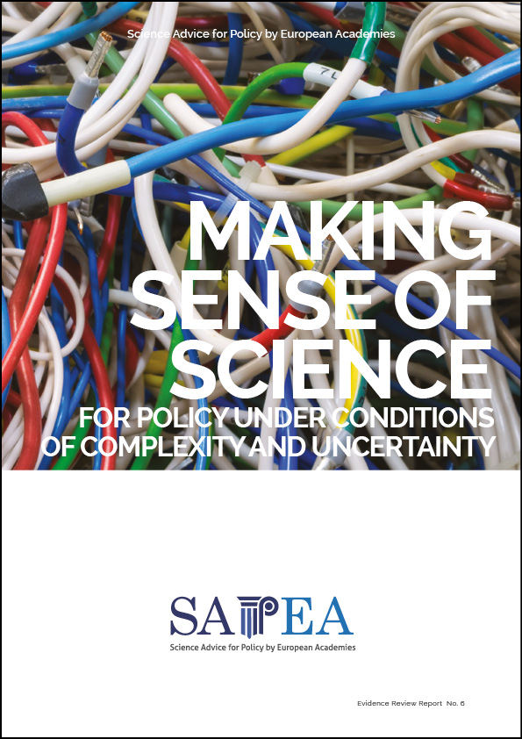

2019
Evidence Review Report Scientific Opinion

