Slide 1
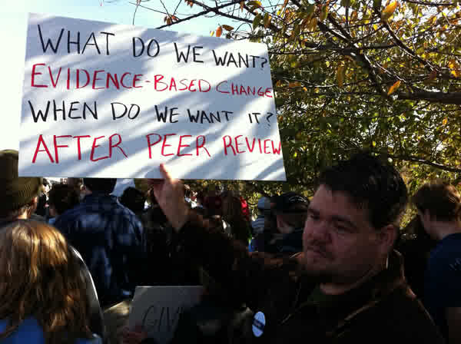
Science advice as seen from a research unit
Kyrre Lekve, Deputy Managing Director

Slide 2
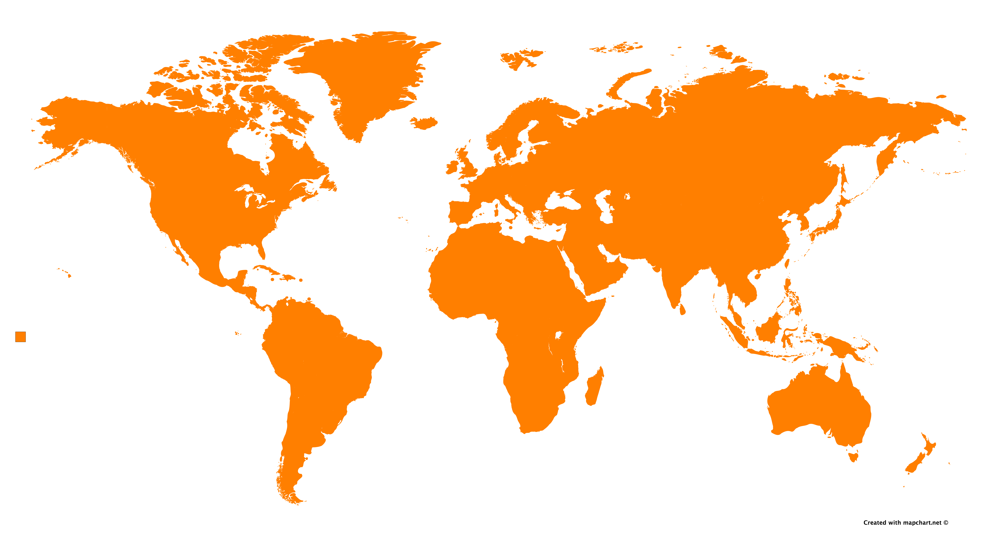
This is Simula
Established: 2001, Simula Research Laboratory
Number of employees: 155
Owner: The Government via the Ministry of Education and Research
Organisation: Limited company (AS)
Financing:
Basic funding:
The Ministry of Education and Research,
The Ministry of Transport and Communications,
The Ministry of Trade, Industry and Fisheries
The Ministry of Justice and Public Security
Research grants:
The Norwegian Research Council
EU
Some private money:
Equinor and other oil (related) companies through Kalkulo
Purpose:
Fundamental ICT-research with applicable goals
Education
Innovation
NORWAY
52%
AMERICA
EUROPE
5%
29%
ASIA
13%
OCEANIA
1%

Slide 3

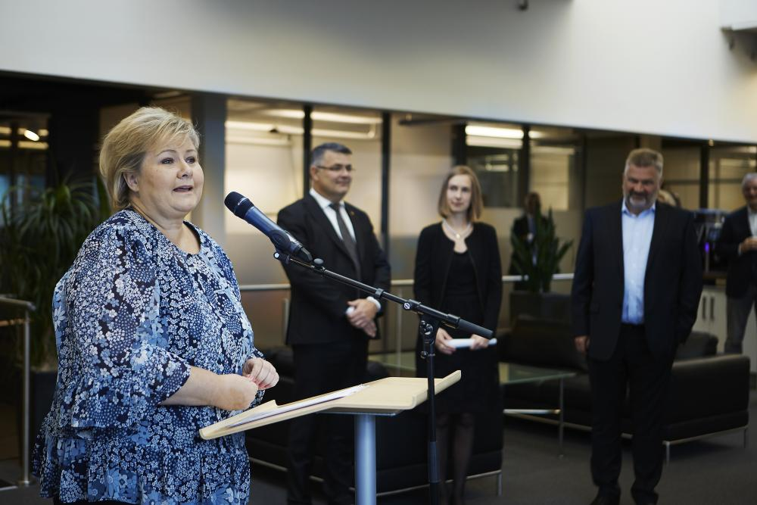
Two ways to science advice
The bureaucrat path
The politician path
Very different!
“We need more people like you”
- Prime Minister Erna Solberg,
visit at Simula 2 Oct 2018

Slide 4

The bureaucrat path
Extensive system in Norway
A necessary basis for political decisions
Fact, realism, clarity etc.
What should Norwegian “science” do?
Don’t promote self-interest disguised as science!
Offer your knowledge
Lesson no.1: Norwegian bureaucrats are excellent!

Slide 5

The Politician path
Totally different game
Secret: Politicians are humans!
What should Norwegian “science” do?
Create win-win situations
“Forankre” in the bureaucrat path
Understand the nature of politics
Demonstrate societal value
Build trust!

Slide 6
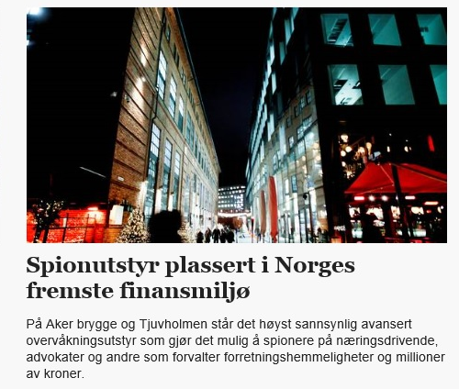
A combination case
Political and bureaucratic interest
Lack of knowledge
Scientists forgot they were scientists
Simula: own analyses, reported to owner
Half year later: scientific consensus

Slide 7
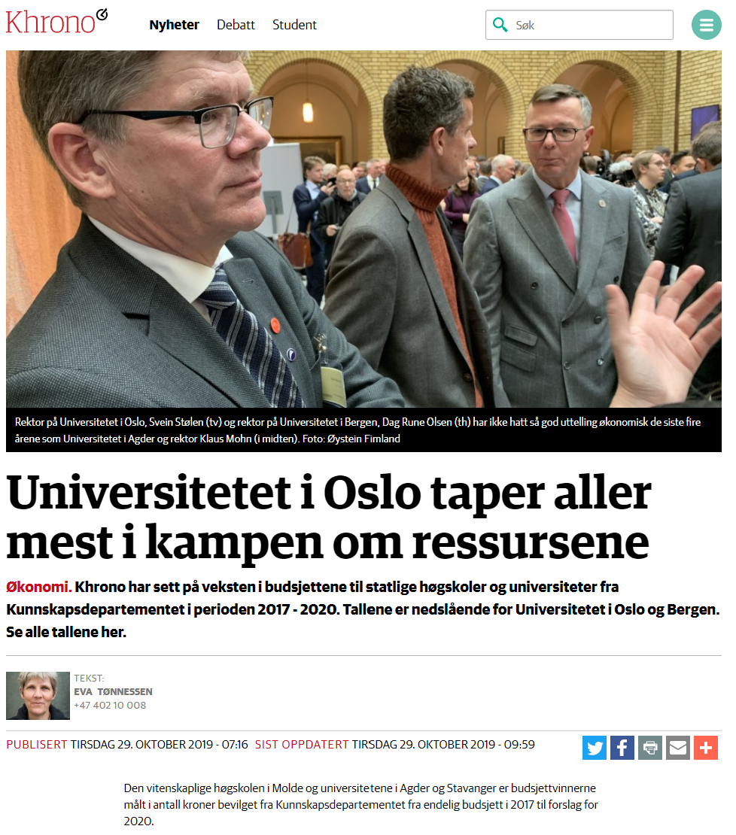
Advice about advice
Distinguish between the two paths – prepare accordingly
Don’t underestimate neither politicians nor bureaucrats
Remember they are humans
Create win-win
Stay scientific and rational!

Slide 8
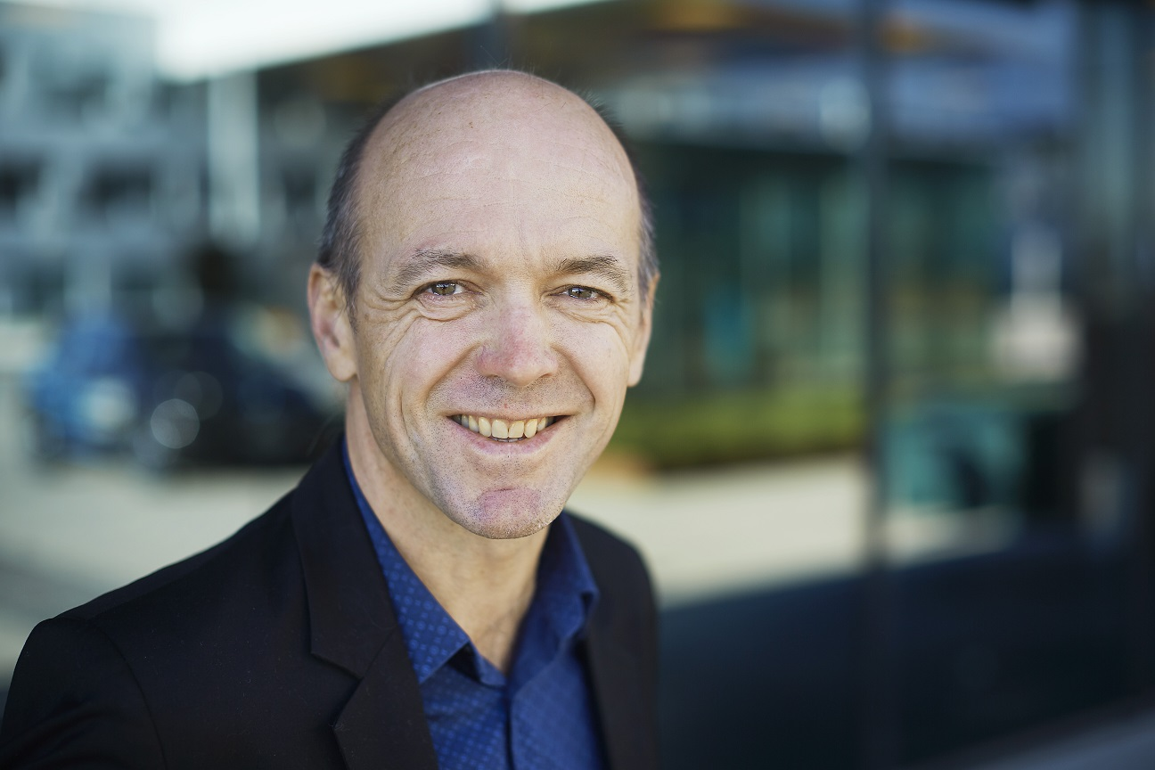
Kyrre.lekve@Simula.no

